Slide 1
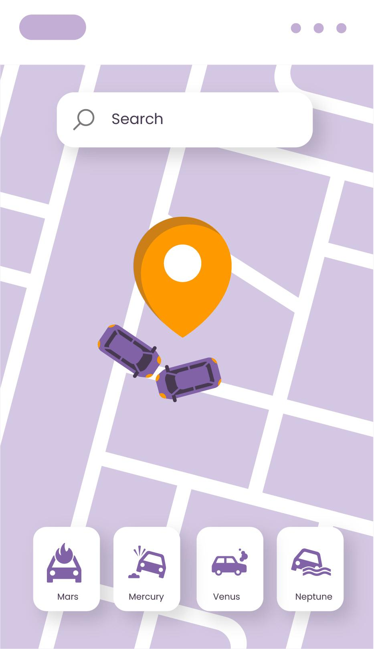
SyncPlate: Connecting all automobiles through their Licence plates
REPORT!

Slide 2
The SyncPlate is based on two major ideas with them being:
Inter-Vehicle communication
Data meshes in Urban systems
Vehicles share real-time data on traffic, hazards, and accidents to improve safety and reroute around congestion. This also aids emergency vehicles by clearing paths more efficiently.
Data meshes enable localized, real-time data sharing between vehicles and infrastructure, improving traffic management and scalability for smart city growth.

Slide 3
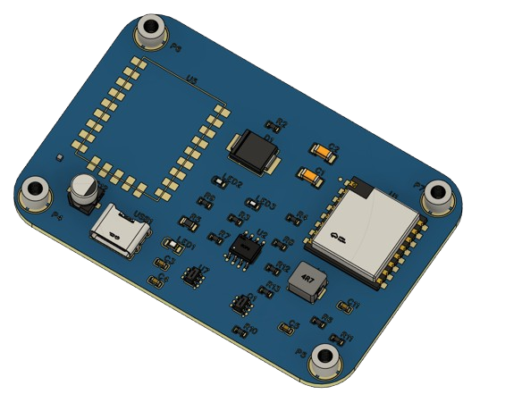
Thus the SyncPlate was born
BLT Antenna
Control IC
Battery regulator
Power Regulator
Mounting Screws
LoRA Attachment

Slide 4


Example Implementation with sample data
An example for this implementation would be our work on implementing a path selection and weighted moving average algorithm to understand how to decongest any given path with a dataset from two time periods and a heat map of activity
The Algorithms and The functions can be seen below:-
Path selection algorithm Weighted Moving Average algorithm

Slide 5
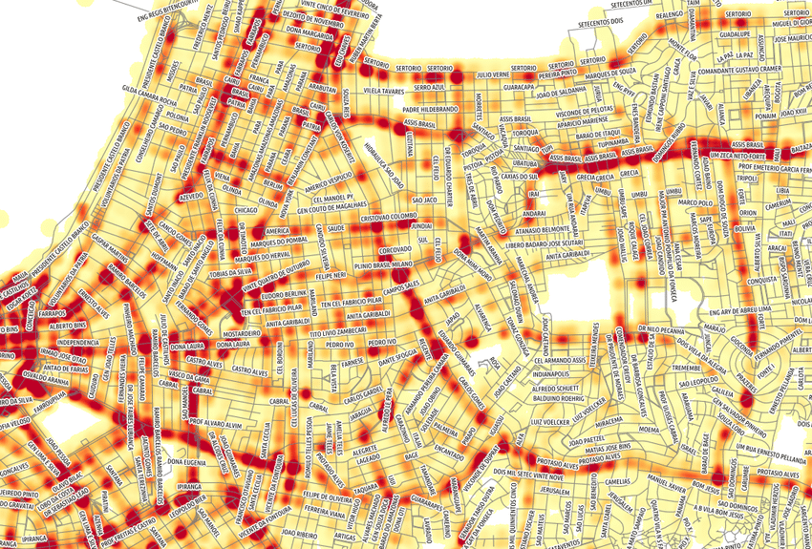
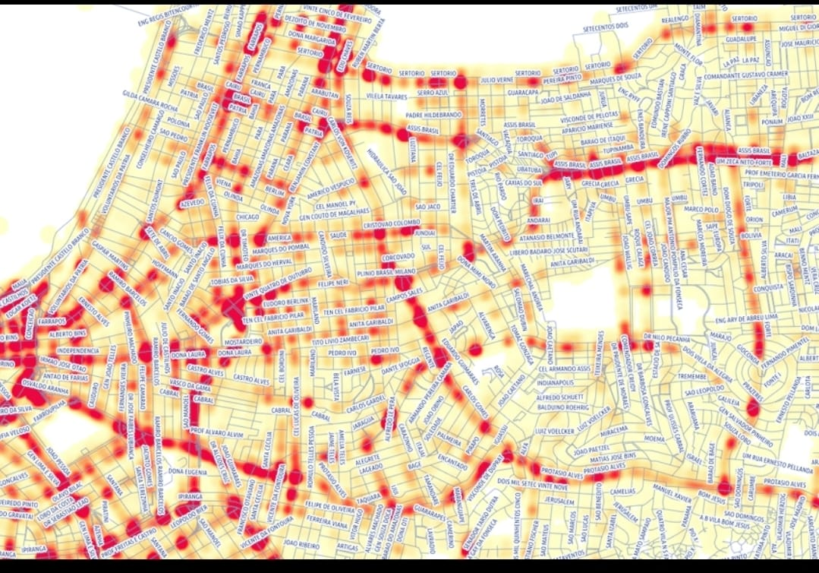
Congestion Before and after

Slide 6
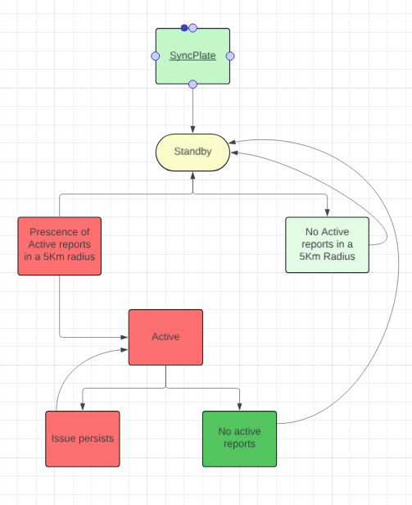

Slide 7
In conclusion ,
SyncPlate is a new approach to road safety, optimization of the movement of traffic, and emergency response by means of providing in-time data exchange from vehicles. This technology can change modern transportation and further advance the improvement of the drivers' safety. Future developments within this area will be directed on ways to expand and integrate this technology into the framework of a smart city.

Slide 8

THANKS!
we’re happy to answer any further questions you may have
aneesharnavchikkala@gmail.com
+91 6302591090
sanjanmithra@gmail.com
+91 8978192258
Please keep this slide for attribution

